Slide 1
Copyright Notice
These slides are distributed under the Creative Commons License.
DeepLearning.AI makes these slides available for educational purposes. You may not use or distribute these slides for commercial purposes. You may make copies of these slides and use or distribute them for educational purposes as long as you cite DeepLearning.AI as the source of the slides.
For the rest of the details of the license, see https://creativecommons.org/licenses/by-sa/2.0/legalcode

Slide 2




Linear Regression with Multiple Variables
Multiple Features
Notes:
https://www.youtube.com/watch?v=jXg0vU0y1ak&list=PLkDaE6sCZn6FNC6YRfRQc_FbeQrF8BwGI&index=22&ab_channel=DeepLearningAI

Slide 3




Multiple features (variables)
Size in feet² (𝑥) Price ($) in 1000’s (𝑦)
2104 | 400
1416 | 232
1534 | 315
852 | 178
… | …
^{𝑓}𝑤,𝑏
𝑥 = 𝑤𝑥 + 𝑏

Slide 4

















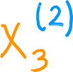


Multiple features (variables)
Size in Number of Number of
Age of home
in years
Price ($) in
$1000’s
feet² bedrooms floors
2104
5
1
45
460
232
315
178
…
1416
3
2
40
1534
852
…
3
2
…
2
1
…
30
36
…
x_{𝑗} = 𝑗^{𝑡ℎ} feature
𝑛 = number of features
_{x} 𝑖
= features of 𝑖^{𝑡ℎ} training example
= value of feature 𝑗 in 𝑖^{𝑡ℎ} training example
_{x} 𝑖
𝑗

Slide 5














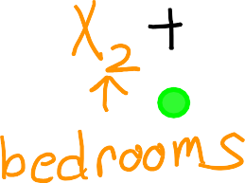
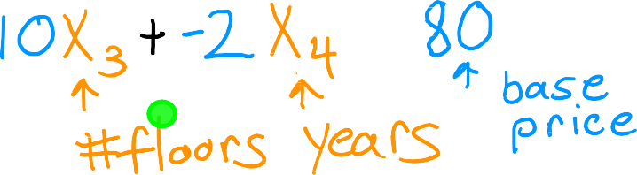

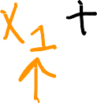






Model:
Previously: 𝑓_{𝑤,𝑏}
𝑥 = 𝑤𝑥 + 𝑏
^{𝑓}𝑤,𝑏
x = 𝑤₁𝑥₁ + 𝑤₂𝑥₂ + ⋯ + 𝑤_{𝑛}𝑥_{𝑛} + 𝑏

Slide 6





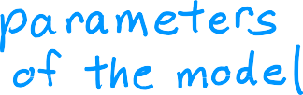
























𝑥 = 𝑤₁𝑥₁ + 𝑤₂𝑥₂ + ⋯ + 𝑤_{𝑛}𝑥_{𝑛} + 𝑏
^{𝑓}𝑤,𝑏
^{𝑓}w,𝑏
x = w ∙ x + 𝑏 =
multiple linear regression

Slide 7
Linear Regression with Multiple Variables
Vectorization Part 1
Vectorization is a neat trick to implement LR

Slide 8


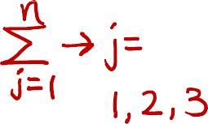
























Parameters and features
Without vectorization
w =
𝑤₁ 𝑤₂ 𝑤₃
𝑏 is a number
x =
𝑥₁ 𝑥₂ 𝑥₃
linear algebra: count from 1
w = np.array([1.0,2.5,-3.3]) b = 4
x = np.array([10,20,30])
f = 0
for j in range(0,n):
f = f + w[j] * x[j]
f = f + b
code: count from 0
Without vectorization
Vectorization
^{𝑓}w,𝑏
x = 𝑤₁𝑥₁ + 𝑤₂𝑥₂ + 𝑤₃ 𝑥₃ + 𝑏
^{𝑓}w,𝑏
x = w ∙ x + 𝑏
f = w[0] | * x[0] | +
w[1] | * x[1] | +
w[2] | * x[2] | + b
f = np.dot(w,x) + b
Andrew Ng

Slide 9
Linear Regression with Multiple Variables
Vectorization Part 2
What is magic behind vectorization that makes it run faster

Slide 10








Without vectorization
Vectorization
for j in range(0,16):
f = f + w[j] * x[j]
np.dot(w,x)
𝑡₀
w[0] w[1]
* *
𝑡₀
…
w[15]
f | + | w[0] | * x[0]
f | + | w[1] | * x[1]
…
*
𝑡₁
x[0] | x[1] | … | x[15]
𝑡₁
…
w[0]*x[0]
+
w[1]*x[1]
+…+
w[15]*x[15]
^{𝑡}15
f + w[15] * x[15]

Slide 11



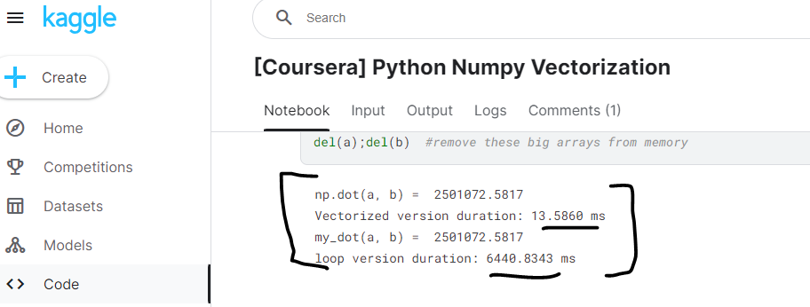



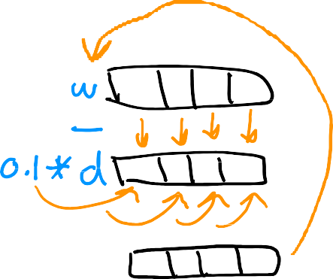
Gradient descent
w = 𝑤₁ 𝑤₂ ⋯
d = 𝑑₁ 𝑑₂ ⋯
^{𝑤}16
^{𝑑}16
w = np.array([0.5, 1.3, … 3.4])
d = np.array([0.3, 0.2, … 0.4])
compute
𝑤_{𝑗} = 𝑤_{𝑗} − 0.1𝑑_{𝑗} for 𝑗 = 1 … 16
Without vectorization
𝑤₁ = 𝑤₁ − 0.1𝑑₁
𝑤₂ = 𝑤₂ − 0.1𝑑₂
⋮
𝑤₁₆ = 𝑤₁₆ − 0.1𝑑₁₆
With vectorization
w = w − 0.1d
for j in range(0,16):
w[j] = w[j] - 0.1 * d[j]
w = w – 0.1 * d
https://www.kaggle.com/code/ipythonx/coursera-python-numpy-vectorization

Slide 12
Linear Regression with Multiple Variables
Gradient Descent for Multiple Regression
Putting math and vectorization together to
implement GD with M LR with vectorization

Slide 13
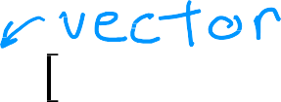













Vector notation
Previous notation
𝑤₁ , ⋯ , 𝑤_{𝑛}
𝑏
Parameters
w =
𝑏
^{𝑓}w,𝑏
𝑤₁ ⋯ 𝑤_{𝑛}
x = w ∙ x + 𝑏
Model ^{𝑓}w,𝑏
Cost function
x = 𝑤₁ 𝑥₁ + ⋯ + 𝑤_{𝑛}𝑥_{𝑛} + 𝑏
𝐽 𝑤₁, ⋯ , 𝑤_{𝑛}, 𝑏
𝐽 w, 𝑏
Gradient descent
repeat {
repeat {
𝑤_{𝑗} = 𝑤_{𝑗} − 𝛼 𝛛 𝐽 𝑤₁, ⋯ , 𝑤_{𝑛}, 𝑏
𝑤 = 𝑤 − 𝛼 𝛛 𝐽 w, 𝑏
𝛛𝑤_{𝑗}
𝑗 𝑗
𝛛𝑤_{𝑗}
𝑏 = 𝑏 − 𝛼 𝛛 𝐽 𝑤₁, ⋯ , 𝑤_{𝑛}, 𝑏
𝑏 = 𝑏 − 𝛼 𝛛 𝐽 w, 𝑏
𝛛𝑏
𝛛𝑏
}
}

Slide 14

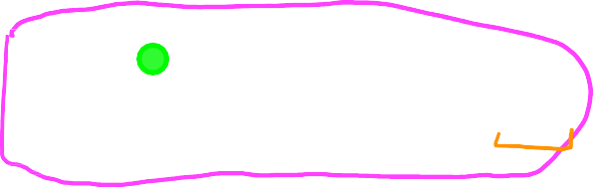









Gradient descent
One feature
𝑛 features
𝑛 ≥ 2
repeat {
repeat {
𝑚
𝑚
1
𝑤 = 𝑤 − 𝛼 ෍ 𝑓
1
𝑤 = 𝑤 − 𝛼 ෍ 𝑓
_{𝑥} 𝑖
_{𝑥} 𝑖
_{x} 𝑖
_{𝑥} 𝑖
− 𝑦 ^{𝑖}
− 𝑦 ^{𝑖}
𝑤,𝑏
1
1 w,𝑏
1
𝑚
𝑚
𝑖=1
𝑖=1
⋮
𝛛 𝐽 w, 𝑏
𝛛
𝛛𝑤₁
_{𝛛𝑤} 𝐽 𝑤, 𝑏
𝑚
1
𝑤 = 𝑤 − 𝛼 ෍ 𝑓
_{x} 𝑖
_{𝑥} 𝑖
− 𝑦 ^{𝑖}
𝑛
𝑛
𝑚
_{𝑚} 𝑖=1
w,𝑏
𝑛
𝑚
^{෍ 𝑓}𝑤,𝑏
𝑖=1
1
𝑚
1
𝑖
𝑖
_{𝑥} 𝑖
𝑏 = 𝑏 − 𝛼 _{𝑚} ෍ 𝑓_{w,𝑏} x − 𝑦
𝑏 = 𝑏 − 𝛼
− 𝑦 ^{𝑖}
𝑖=1
simultaneously update
𝑤_{𝑗} (for 𝑗 = 1, ⋯ , 𝑛) and 𝑏
simultaneously update 𝑤, 𝑏
}
}

Slide 15

An alternative to gradient descent (w, b)
Normal equation
Only for linear regression
Solve for w, b without
iterations
Disadvantages
Doesn’t generalize to other
learning algorithms.
Slow when number of features
is large (> 10,000)
What you need to know
Normal equation method may be used in machine learning libraries that implement linear regression.
Gradient descent is the
recommended method for finding parameters w,b
https://www.kaggle.com/code/mwaseem75/multiple-variable-linear-regression

Slide 16
Practical Tips for Linear Regression
Feature Scaling Part 1
Most widely used learning algorithm today –learning rate and
Picking scaling features tricks – making LR work much better

Slide 17





















Feature and parameter values
𝑥₁: size (feet²)
range: 300 − 2,000
𝑥₂: # bedrooms
range: 0 − 5
= 𝑤₁ 𝑥₁ + 𝑤₂𝑥₂ + 𝑏
House: 𝑥₁ = 2000, 𝑥₂ = 5, 𝑝𝑟𝑖𝑐𝑒 = $500k
size of the parameters 𝑤₁ , 𝑤₂?
𝑤₁ = 50, 𝑤₂ = 0.1, 𝑏 = 50 𝑤₁ = 0.1, 𝑤₂ = 50, 𝑏 = 50
𝑝𝑟𝑖𝑐𝑒 = 50 ∗ 2000 + 0.1 ∗ 5 + 50 𝑝𝑟𝑖𝑐𝑒 = 0.1 ∗ 2000𝑘 + 50 ∗ 5+5 0
𝑝𝑟𝑖𝑐𝑒 = $100,050.5k 𝑝𝑟𝑖𝑐𝑒 = $500k

Slide 18

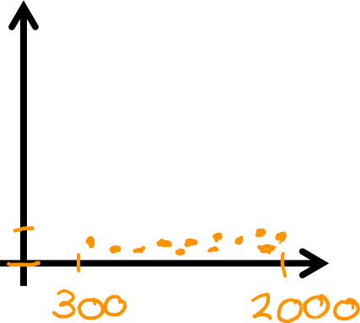
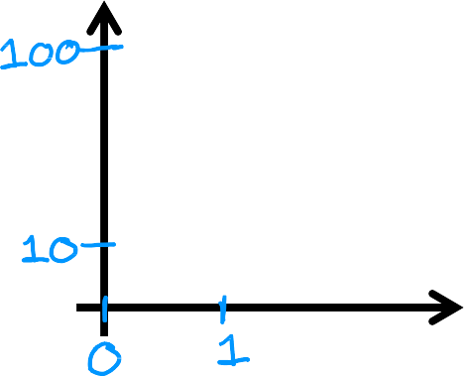
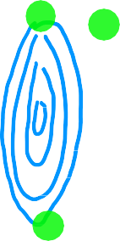


Feature size and parameter size
 | size of feature 𝑥_{𝑗} | size of parameter 𝑤_{𝑗}
size in feet²
#bedrooms
Features
Parameters
𝐽 w, 𝑏
𝑥₂
# bedrooms
𝑤₂
# bedrooms
𝑥₁ size in feet²
𝑤₁ size in feet²

Slide 19
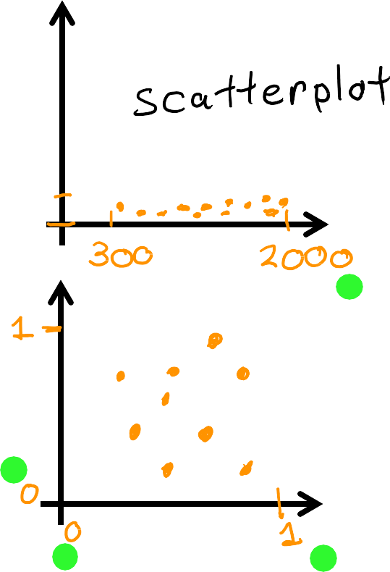
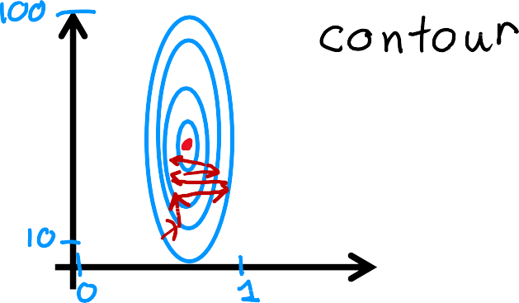

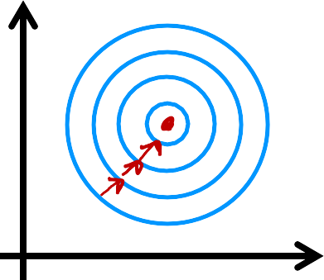
Feature size and gradient descent
Features Parameters
𝑥₂
# bedrooms
𝑤₂
# bedrooms
𝐽 w, 𝑏
When you have different features which takes on different range of values
Can cause GD to run slowly but re-scaling so different features can make GD run faster
𝑥₁ size in feet²
𝑤₁ size in feet²
𝑥₂
# bedrooms
rescaled
𝑤₂
# bedrooms rescaled
𝐽 w, 𝑏
𝑥₁ size in feet²
𝑤₁ size in feet²
rescaled
rescaled

Slide 20
Practical Tips for Linear Regression
Feature Scaling Part 2
How do you actually rescale the features? Let's learn.

Slide 21
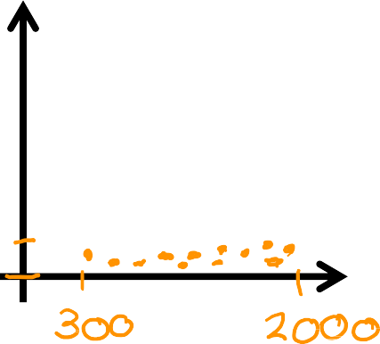




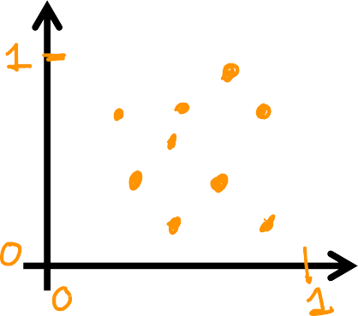



Feature scaling
𝑥₂
# bedrooms
300 ≤ 𝑥₁ ≤ 2000
0 ≤ 𝑥₂ ≤ 5
𝑥₁ size in feet²
𝑥
𝑥
₌ 1
₌ 2
𝑥
𝑥
1,𝑠𝑐𝑎𝑙𝑒𝑑
2000
2,𝑠𝑐𝑎𝑙𝑒𝑑
5
𝑥₂
# bedrooms rescaled
0.15 ≤ 𝑥_{1,𝑠𝑐𝑎𝑙𝑒𝑑} ≤ 1
^{0 ≤ 𝑥}2,𝑠𝑐𝑎𝑙𝑒𝑑 ^{≤ 1}
𝑥₁ size in
feet² rescaled

Slide 22
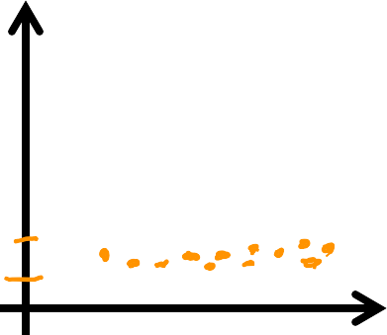









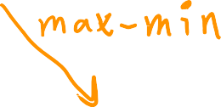
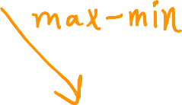





Mean normalization
300 ≤ 𝑥₁ ≤ 2000
0 ≤ 𝑥₂ ≤ 5
𝑥₂
# bedrooms
𝑥₁ − 𝜇₁
𝑥₂ − 𝜇₂
𝑥 =
𝑥 =
1
2000−300
2
5−0
𝑥 size
1
in feet²
𝑥₂
# bedrooms normalized
−0.18 ≤ 𝑥₁ ≤ 0.82
−0.46 ≤ 𝑥₂ ≤ 0.54
𝑥₁ size in feet²
normalized

Slide 23
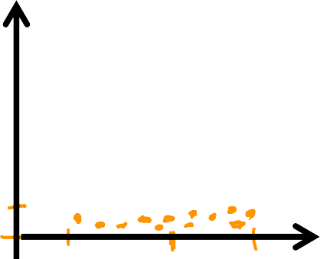

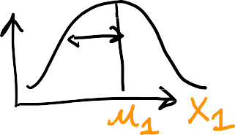










Z-score normalization
standard deviation 𝜎
300 ≤ 𝑥₁ ≤ 2000
0 ≤ 𝑥₂ ≤ 5
𝑥₂
# bedrooms
𝜎₁ = 450
𝜎₁
𝜎 = 1.4
2
𝑥₁ − 𝜇₁
𝑥 =
𝑥₂ − 𝜇₂
𝑥 =
𝑥₁ size in feet²
1
𝜎
2
𝜎₂
1
𝑥₂
# bedrooms normalized
−1.6 ≤ 𝑥₂ ≤ 1.9
−0.67 ≤ 𝑥₁ ≤ 3.1
𝑥₁ size in feet²
normalized

Slide 24
























Feature scaling
aim for about −1 ≤ 𝑥_{𝑗} ≤ 1 for each feature 𝑥_{𝑗}
−3 ≤ 𝑥_{𝑗} ≤ 3
−0.3 ≤ 𝑥_{𝑗} ≤ 0.3
0 ≤ 𝑥₁ ≤ 3
−2 ≤ 𝑥₂ ≤ 0.5
−100 ≤ 𝑥₃ ≤ 100
−0.001 ≤ 𝑥₄ ≤ 0.001
98.6 ≤ 𝑥₅ ≤ 105
There is almost no harms in performing features scaling to
have a practice to do it. Also helps GD to run much faster.

Slide 25
Practical Tips for Linear Regression
Checking Gradient Descent for Convergence
How do you know if GD is working - finding
global minimum or something close to it

Slide 26

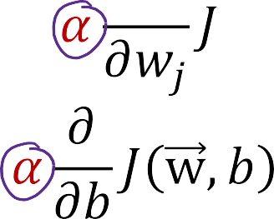

Gradient descent

Slide 27
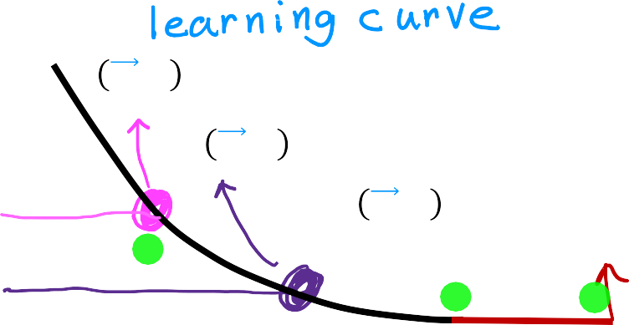





Make sure gradient descent is working correctly
𝐽 w, 𝑏 should decrease
objective: min 𝐽 w, 𝑏
w,𝑏
after every iteration
Automatic convergence test Let 𝜀 “epsilon” be 10⁻³.
If 𝐽 w, 𝑏 decreases by ≤ 𝜀
𝐽 w, 𝑏
𝐽 w, 𝑏 after 100 iterations
𝐽 w, 𝑏 after 200 iterations
𝐽 w, 𝑏 likely converged by 400 iterations
0 100 200 300 400
# iterations 𝑤, 𝑏
# iterations needed varies
𝐽 w, 𝑏
𝐽 w, 𝑏 after 100 iterations
𝐽 w, 𝑏 after 200 iterations
𝐽 w, 𝑏 likely converged by 400 iterations
0 100 200 300 400
# iterations 𝑤, 𝑏
# iterations needed varies
in one iteration,
declare convergence. (found parameters w, 𝑏
to get close to
global minimum)

Slide 28
Practical Tips for Linear Regression
Choosing the Learning Rate

Slide 29

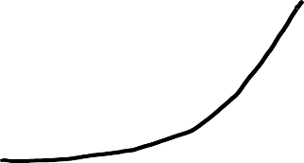




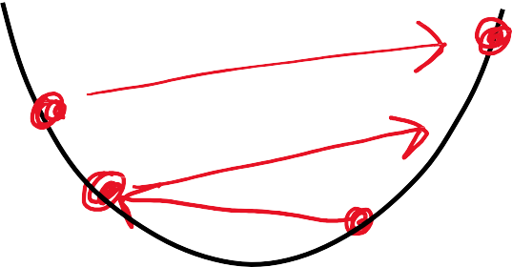
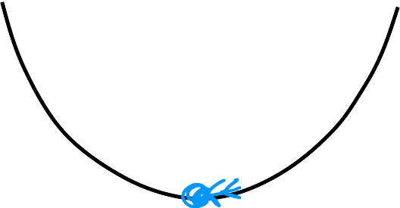
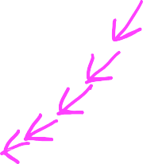



Identify problem with gradient descent
learning rate is too large
or
𝛼 is too large
𝑤₁ = 𝑤₁ + 𝛼𝑑₁
use a minus sign
𝑤₁ = 𝑤₁ − 𝛼𝑑₁
𝐽 𝑤, 𝑏
𝐽 𝑤, 𝑏
# iterations
# iterations
Adjust learning rate
With a small enough 𝛼,
𝐽 w, 𝑏 should decrease on every iteration
𝛼 is too big
Use smaller 𝛼
𝐽 𝑤, 𝑏
𝐽 𝑤, 𝑏
If 𝛼 is too small, gradient descent takes a lot more iterations to converge
parameter 𝑤₁
parameter 𝑤₁

Slide 30









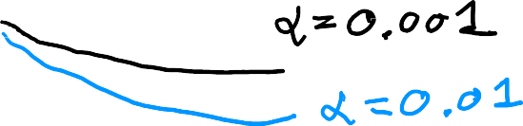
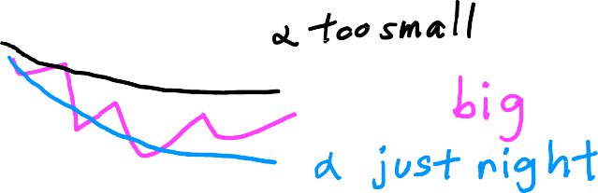

Values of 𝛼 to try:
… 0.001
0.01
0.1
1 …
J w, b
J w, b
# iterations
# iterations

Slide 31
Practical Tips for Linear Regression
Feature Engineering

Slide 32
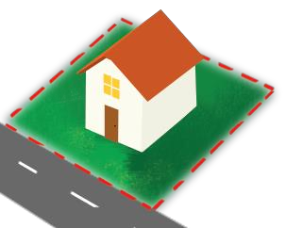

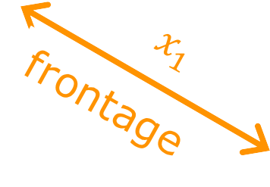



Feature engineering
^{𝑓}w,𝑏
x = 𝑤₁ 𝑥₁ + 𝑤₂ 𝑥₂ + 𝑏
𝑎𝑟𝑒𝑎 = 𝑓𝑟𝑜𝑛𝑡𝑎𝑔𝑒 × 𝑑𝑒𝑝𝑡ℎ
𝑥₃ = 𝑥₁𝑥₂
Feature engineering: Using intuition to design new features, by transforming or combining original features.
^{𝑓}w,𝑏
x = 𝑤₁𝑥₁ + 𝑤₂𝑥₂ + 𝑤₃𝑥₃ + 𝑏
Andrew Ng

Slide 33
Practical Tips for Linear Regression
Polynomial Regression
Allows you to fit not only lines for curves – one flavor
of feature engineering

Slide 34
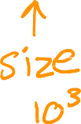

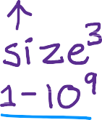
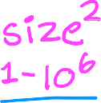









Polynomial regression
^{𝑓}𝑤,𝑏
𝑥 = 𝑤₁𝑥 + 𝑤₂𝑥² + 𝑤₃𝑥³ + 𝑏
price y
^{𝑓}𝑤,𝑏
𝑥 = 𝑤₁𝑥 + 𝑤₂𝑥² + 𝑏
size x

Slide 35
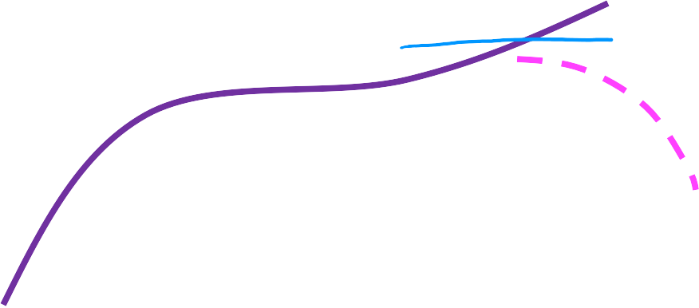











Choice of features
^{𝑓}w,𝑏
𝑥 = 𝑤₁𝑥 + 𝑤₂ 𝑥 + 𝑏
price y
size x

Slide 36
Choice of features
^{𝑓}𝑤,𝑏
𝑥 = 𝑤₁𝑥 + 𝑤₂𝑥² + 𝑤₃𝑥³ + 𝑏
^{𝑓}w,𝑏
𝑥 = 𝑤₁𝑥 + 𝑤₂ 𝑥 + 𝑏
price y
size x

